Slide 1



Prediction of Space X Falcon 9 Landing
Ingrid T Quiroz
9/1/2023

Slide 2

Outline
Executive Summary
Introduction
Methodology
Results
Conclusion
Appendix

Slide 3
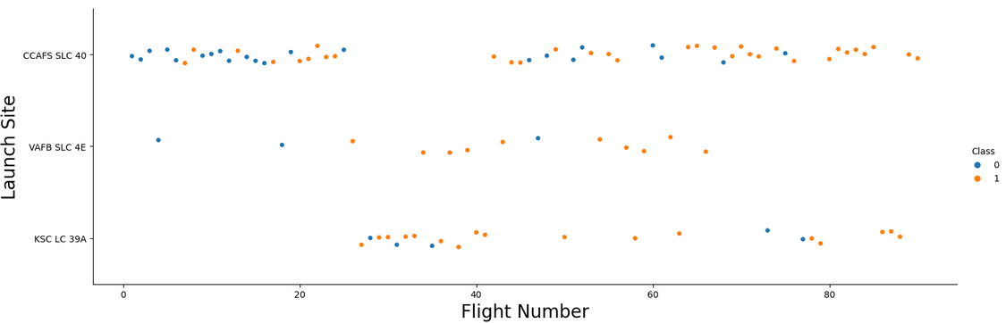
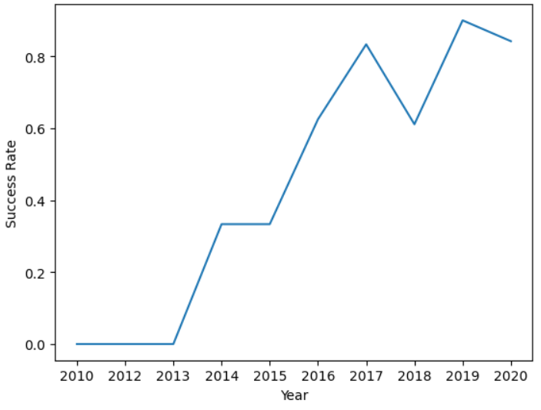
Executive Summary
Summary of methodologies:
Data collection of previous landings.
Data interpolation (replace missing values).
Exploratory Data Analysis – Visualizing the patterns, trends and making inferences about the next launch (Graphs 1 & 2)
Use Machine Learning to predict the success rate of the Falcon 9’s first stage launch.
Graph 1.
Summary of all results
The methodology followed produced graphs and maps visualizing the place of past launchings.
A classification model to predict the success of the launch was created.
Graph 2.

Slide 4
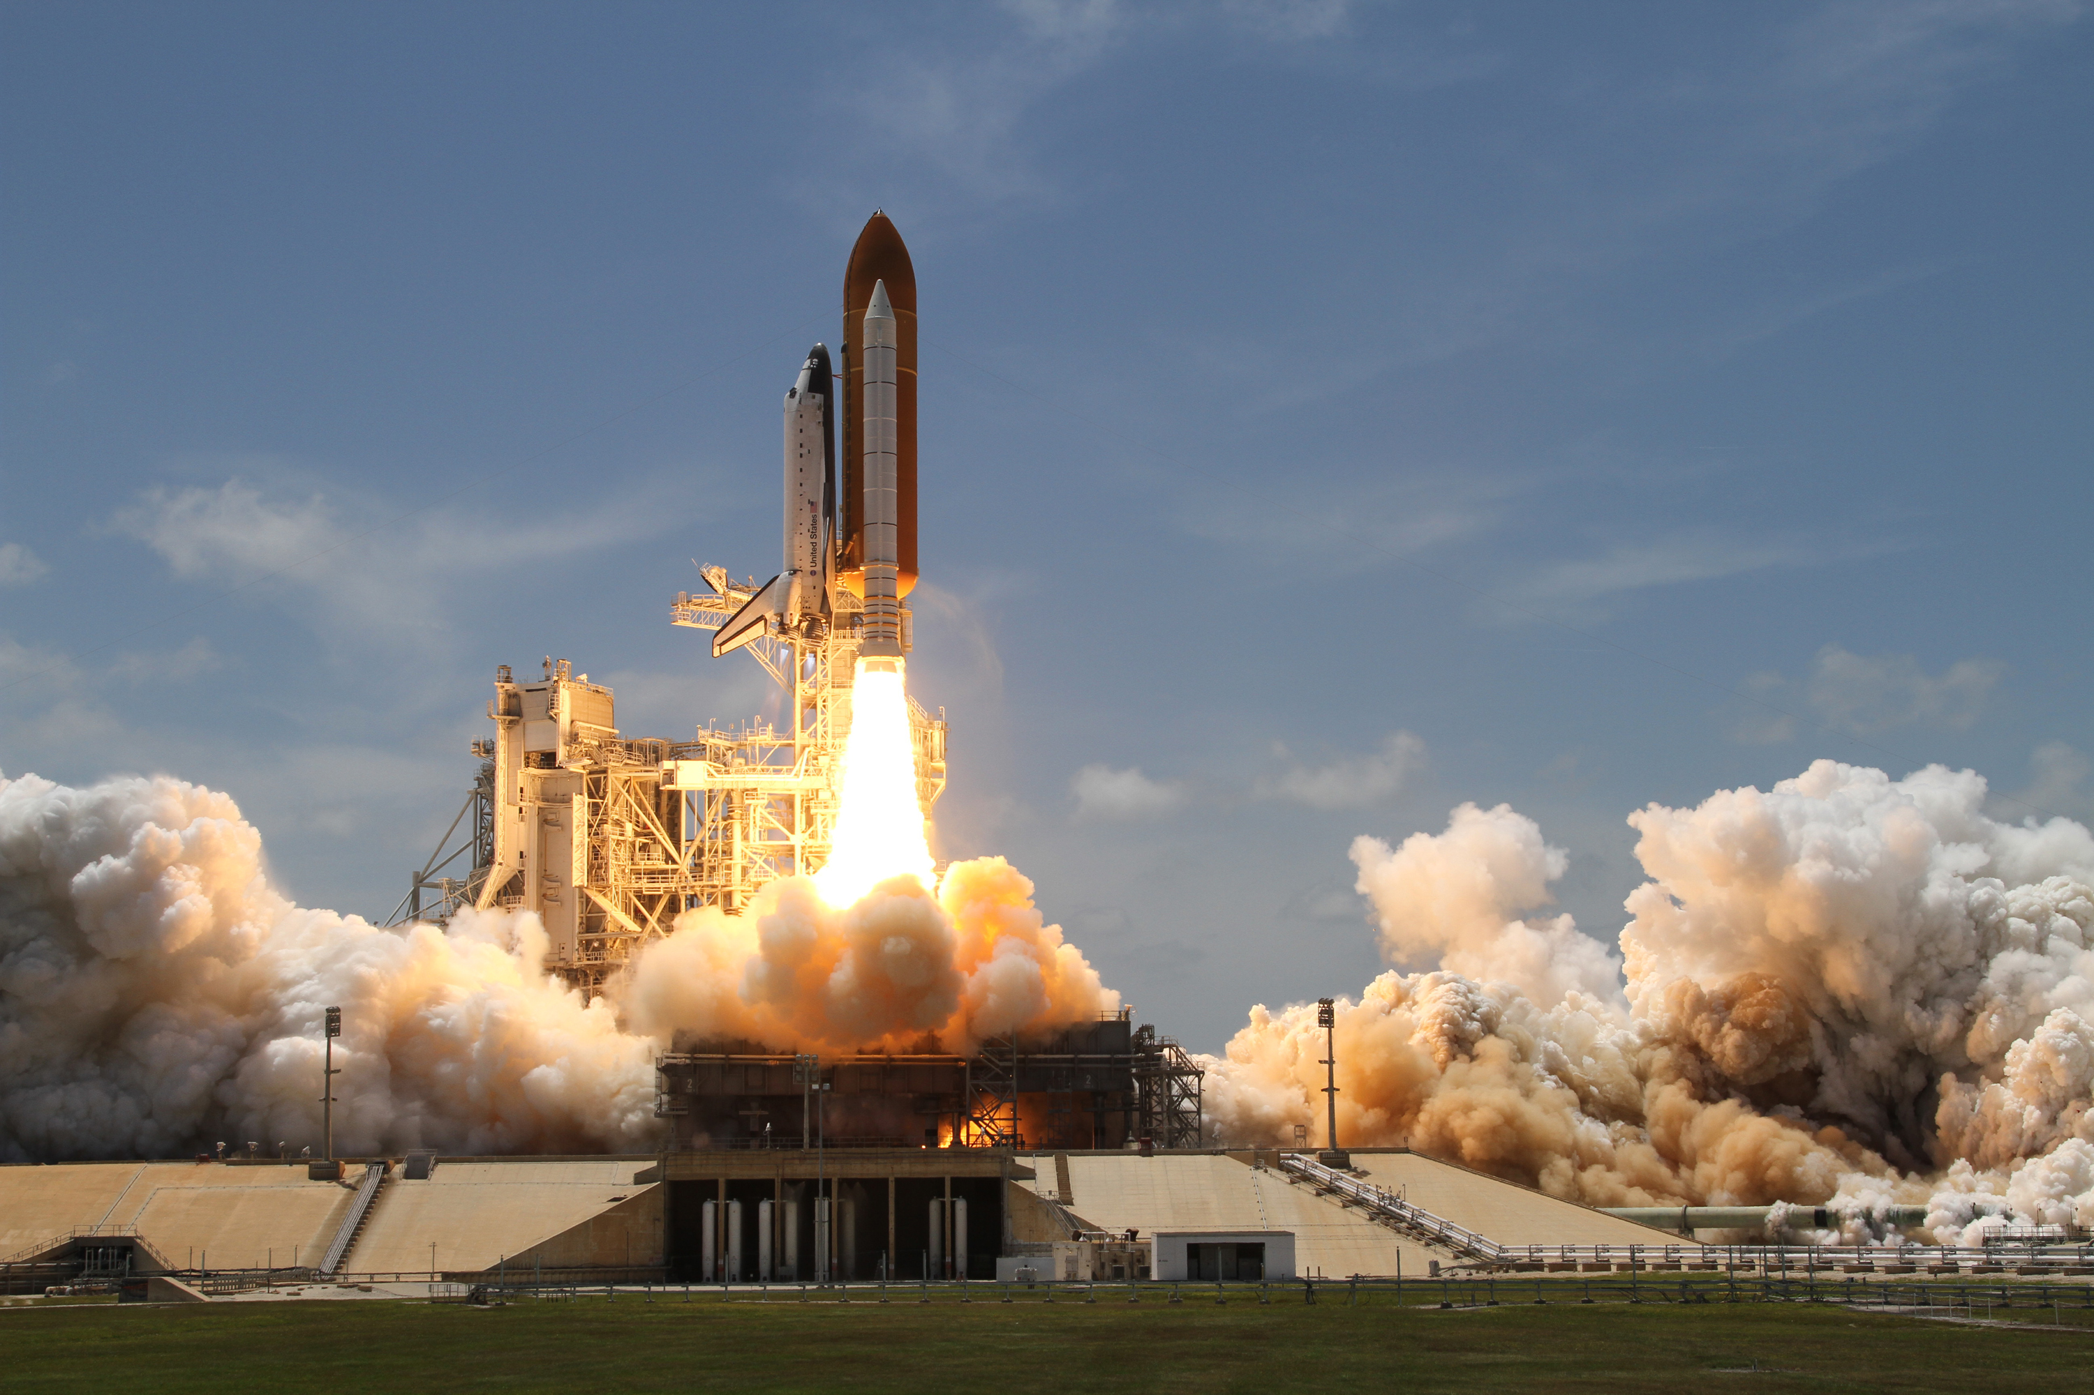
Introduction
The objective of this project is to predict the success of the first stage landing, to then, calculate the cost of the launch. Space X advertises Falcon 9’s rocket launch cost to be around $62M, whereas other providers’ costs may go as high as $165M.
Our goal is to predict the success rate of the next launch. By predicting the outcome, we are able to subsequently determine the cost. This information will aid SpaceX to assess whether it is more financially conservative to allow a third-party company to place a bid for the next launch since SpaceX is already able to offset their launch costs because they reuse the first stage of the rocket.

Slide 5


Slide 6
Methodology
Executive Summary
Data collection methodology.
Data wrangling.
Exploratory data analysis (EDA) using visualization and SQL
Interactive visual analytics using Folium.
Predictive analysis using classification models.

Slide 7
Data Collection
The first exercise of the project was to retrieve data directly from the SpaceX REST API. The goal of this exercise was to predict Space X’s attempt to land a rocket or not.
We started with loading the URL into python as a .json file, which required the function to normalize it to be suitable as a Pandas DataFrame.

Slide 8
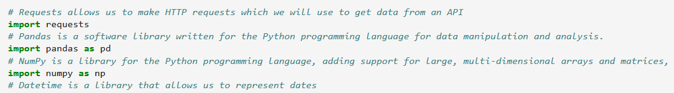
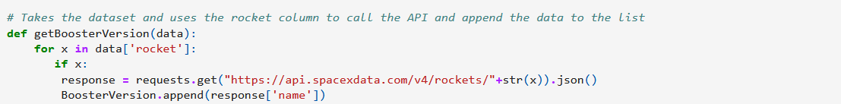
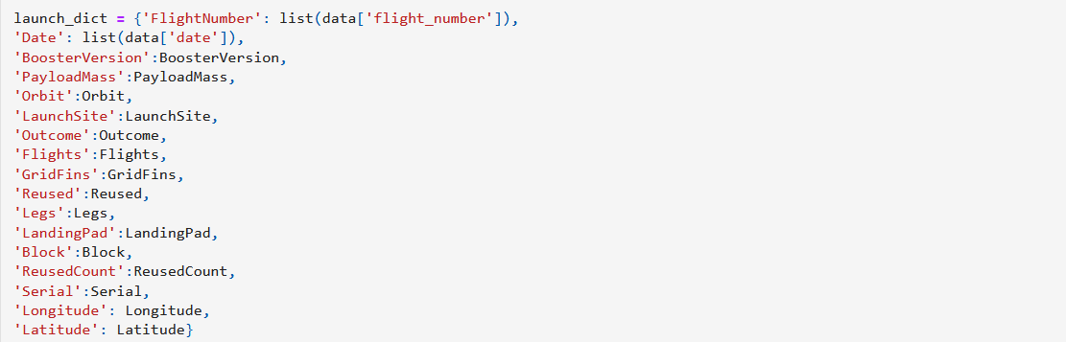
Data Collection – SpaceX API
The objectives of this exercise were:
Request to the SpaceX API
Clean up the requested data.
The steps taken:
- Transform the json file to a pandas dataframe.
Import libraries (requests, numpy and pandas) to retrieve the columns desired (rocket, long, lat, launchpad, payloads, mass, orbit, etc.)
Get the rocket launch data from “Launches”.
Decode and parse the “Launches” data into a dataframe.
Filter the dataframe to include only the values pertaining to “Falcon 9”

Slide 9
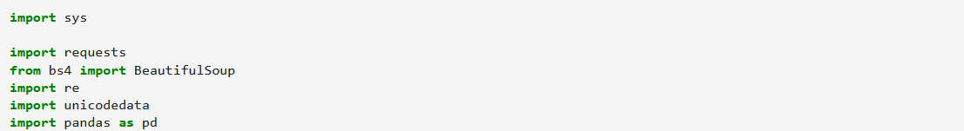
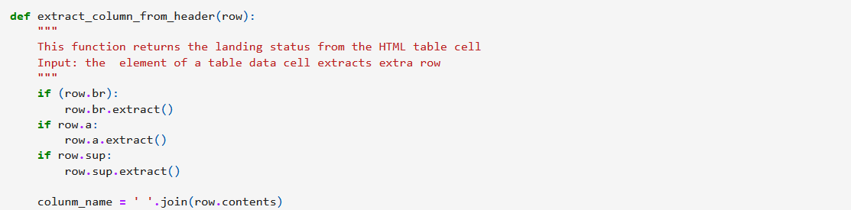
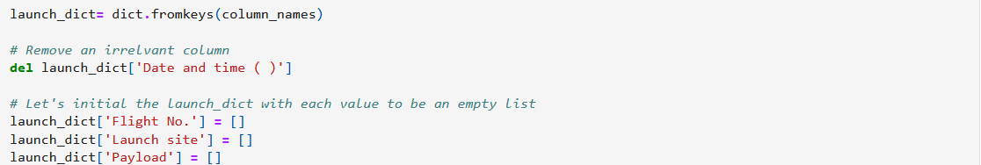
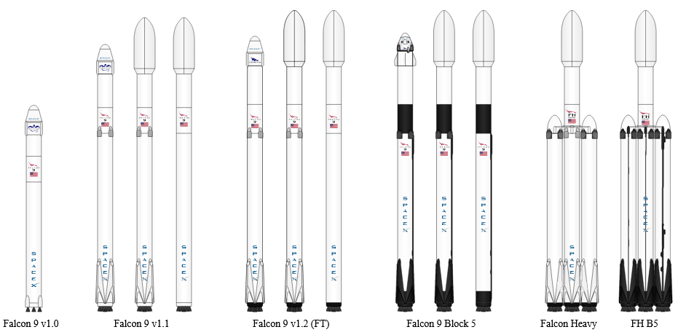
Data Collection - Scraping
After obtaining the information of unsuccessful launches from an HTML table, these were the following steps taken:
- Using BeautifulSoup, import the aforementioned HTML table.
- Collect all column names from the table.
- Create a dataframe using the extracted column names as a dictionary.

Slide 10
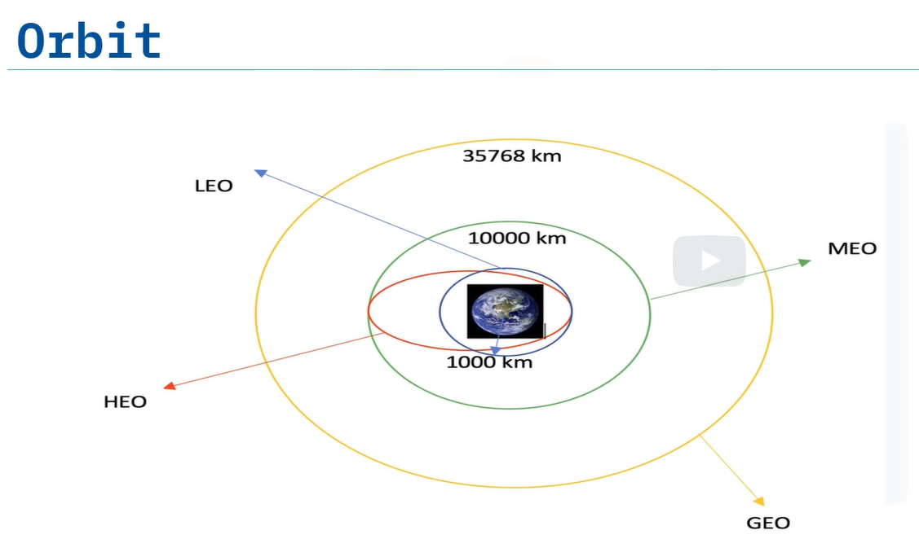
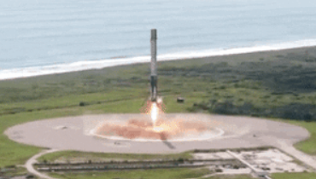
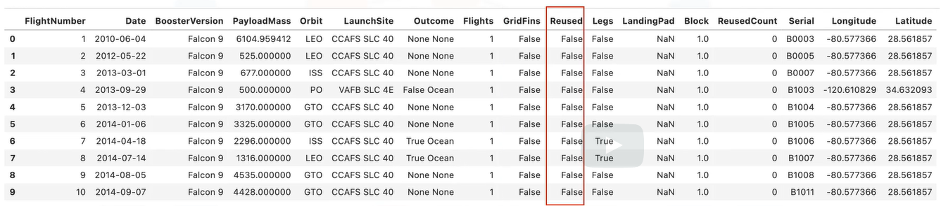
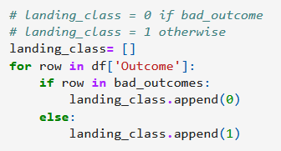
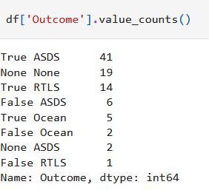
Data Wrangling
The process to test a supervised model consisted of separating the orbits and obtaining the values such as the number of launches per site, number of occurrence of each orbit and the landing outcome per respective orbit type.
The next step was to classify the boosters' landings outcome into:
True Ocean - Mission outcome was successfully landed to a specific region of the ocean.
False Ocean - Mission outcome was UNsuccessfully landed to a specific region of the ocean.
True RTLS - Mission outcome was successfully landed to a ground pad.
False RTLS - Mission outcome was UNsuccessfully landed to a ground pad.
True ASDS - Mission outcome was successfully landed to a drone ship.
False ASDS - Mission outcome was UNsuccessfully landed to a drone ship.
None ASDS/None None – Failure to Land.
Since our main goal is to analyze the likelihood of success of the next launching, we first have to examine the success rate of past data points. Therefore, the column “landing_class” is created based on the values of “Outcome” column, such that all values that were not “True Ocean/RTLS, etc” are stored as in the set “bad_outcome”, represented by the number 0, and the successful landings being stored as 1.

Slide 11
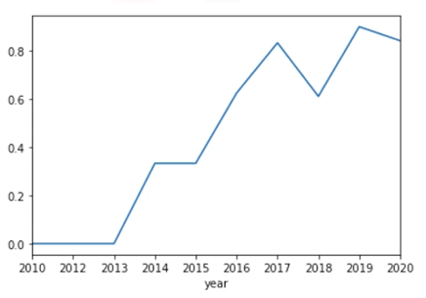
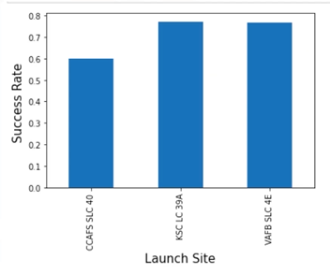
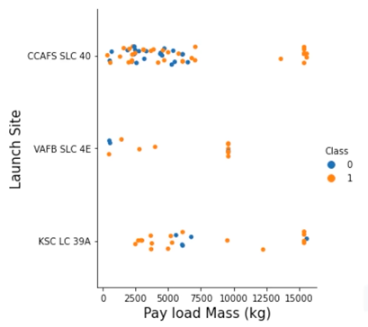
EDA with Data Visualization
Exploratory Data Analysis was performed using the data directly mined from a database, and then plotted in different graphs to analyze trends.
Line graph – Used to observe the success rate of the Falcon 9’s launch over the years.
Bar graph – Used to compare the landing success rate of each launch site.
Scatter plot – Used to aid with finding a correlation between pay load mass and success rate per launch site.

Slide 12
EDA with SQL
The first step to mine the data was to connect to the database by importing sqlite3, using python.
Select all values from the table “spacextbl”.
Find all distinct launch sites from the table.
Filter only the Launch Sites that begin with “KSC”.
Add the values from Payload mass as “Total Payload” where values from the “Customer” field is equal to “NASA (CRS)”.
Obtain the average of the column “Payload Mass KG” where the Booster Version is equal to “F9 v1”.
Select all the different “Landing Outcomes” from the table; the results: Failure (parachute), no attempt, uncontrolled, Success, Failure, etc.
The next step was to find the date of the earliest successful landing outcome for a drone ship.
Find the boosters that had a successful outcome in a ground pad, which payload mass is between 4000-6000lbs.
As an additional step, the outcomes were normalized as either a failure or success.
Next, the query was set to list all the booster versions that have carried the maximum payload mass.
It was proceeded to list all successful landing outcomes for ground pad, along with the booster version and launch site by month for the 2017 year. This method consisted of stripping the month from the date field and assigning the month names to the numbers, i.e. 1 being January.
Lastly, all landing outcome categories (No attempt, Success (ground pad), Failure, etc) between the dates of 2010-2017 was ranked by the amount of attempts.

Slide 13
Build an Interactive Map with Folium
1) Mark all Launch Sites on the map against the NASA Centers.
It’s very important to be able to visualize the results in charts or graphs, but observing the data points directly on the map can give the user a different insight.
Using python, the libraries folium and pandas were imported first. Next, to generate the map, the object Map was called upon.
Next, all site’s location were plotted on the map by importing the coordinates from a csv file. Once the locations were plotted, folium.Circle was called to highlight the circle area where the NASA Johnson Space was located. A folium.Marker was also added for each launch site.
2) Mark the successful/failed launches per site on the map.
Create markers for all launch records, and splitting them by color based on their class – 1 being successful & green, and 0 being red & failure.
The column marker_color is added to store the corresponding color with its respective number. The object MarkerCluster is used to cluster those sites along with folium.Marker to highlight the sites within the cluster.
3) Calculate the distance between the launch site and its proximities.
To calculate the distance between the site and the MousePosition the lat and long were found by importing sin,cos, sqrt, atan2, and radians. After finding the lat and long, folium.Polyline was called to plot a line between the launch site and the placement of the mouse.

Slide 14
Predictive Analysis (Classification)
To accurately predict the outcome of the next launching the exploratory analysis was split into training labels to find the best classification model.
Development:
- Load the dataframe by importing fetch and pulling the results from the url. These results will be stored and read as a csv file, later named X.
- Transform the data from the column “class” from table X, into an array by using to_numpy(). This column will now be named Y.
- The data in X, basically the number of rows and number of columns, will be reassigned as X.
Testing accuracy of model:
- Split the data into training and testing by calling the function train_test_split.
- Using GridSearchCV and logreg_cv find the best parameters for this logistic regression. With score calculate the accuracy percentage of the test and repeat the process with other models.
- Plot the confusion matrix and identify the problem – false positive in this case “did not land & land”
Results:
- With GridSearchCV each algorithm was stored as an object which was fitted to the parameters (obtained as dictionaries from each algorithm).
- All possible models for this exercise were tested, and ultimately, the model that wielded the highest accuracy score was deemed as the best performing model.

Slide 15
Results
Exploratory data analysis results
Interactive analytics demo in screenshots
Predictive analysis results

Slide 16


Slide 17
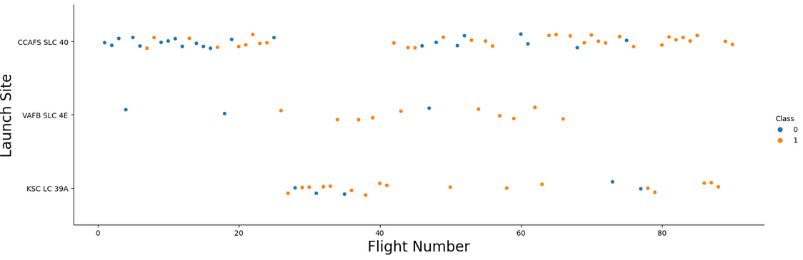
Flight Number vs. Launch Site
The scatter plot above shows a positive correlation between an increase of flight frecuency per site and the success rate. For instance, over 80 flights done on CCAF5 proved to be successful.
There is a general trend with low number flights had a higher failure rate.
Most of the flights over 40 seemed to have the most success.

Slide 18
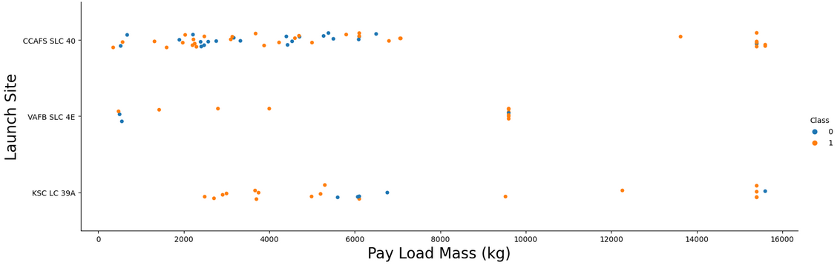
Payload vs. Launch Site
Here, we may observe that higher Pay Load Mass, greater than 10000kg, correlated to virtually low failure rates. Though we are lacking more datapoints with pay load masses over 10000 kg.
No Launch site has a definite correlation between Pay Load Mass and success rate. All launch sites seemed to have a mixture of success and failures at any given Pay Load Mass.

Slide 19
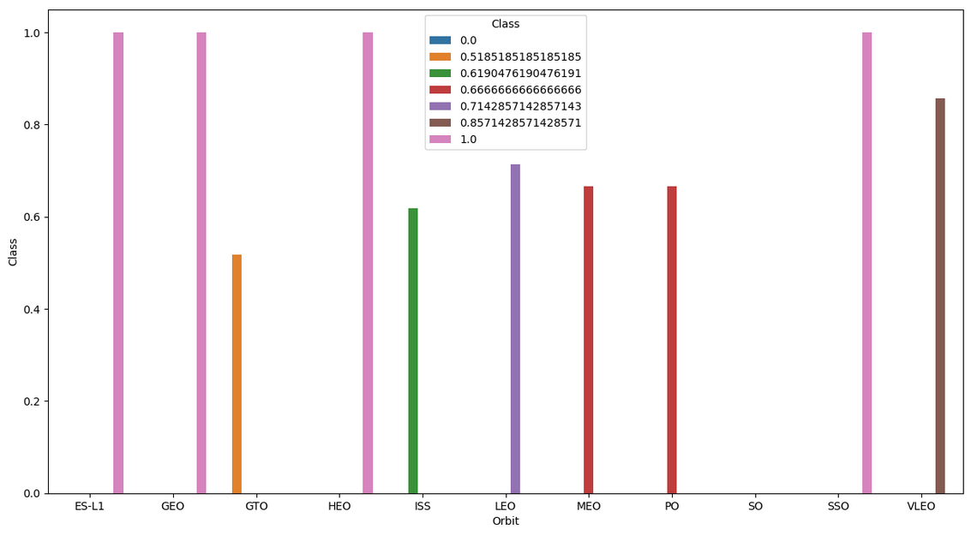
Success Rate vs. Orbit Type
Some worthy observations from this bar graph:
- All ES-L1, GEO, HEO and SSO had a 100% success rate.
- The least successful orbit is SO.

Slide 20
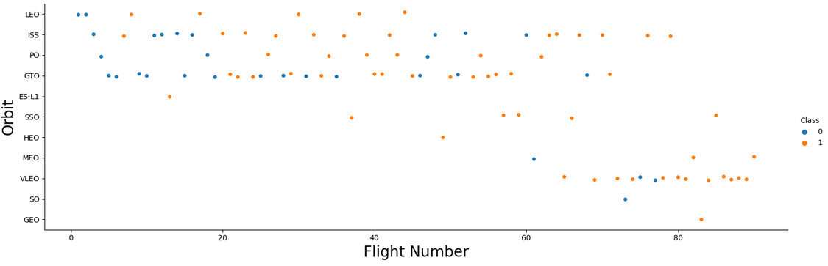
Flight Number vs. Orbit Type
This scatter plot sheds some light into the afore mentioned statistics – the 100% success rate of said orbits are largely, if not entirely, due to the fact that only 1 flight per orbit was launched. Without a larger sample, the success rate cannot be accurately determined.
As found earlier, the higher frequency of launches, the higher the success rate becomes.

Slide 21
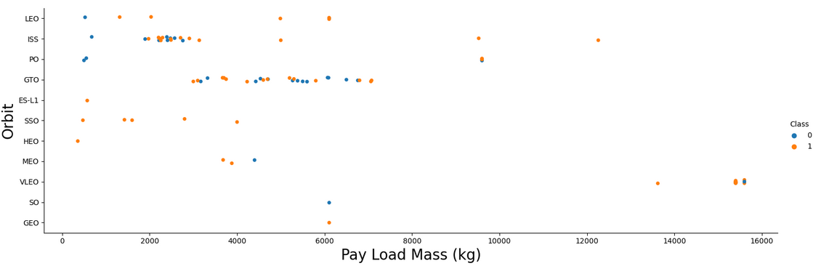
Payload vs. Orbit Type
The SO orbit seems to be the most successful at high Pay Load mass, however, this observation could drastically change with more data available.
The orbit GTO’s success rate is inconclusive – all data points are clustered together. The likelihood of success seems equal to that of failure.

Slide 22
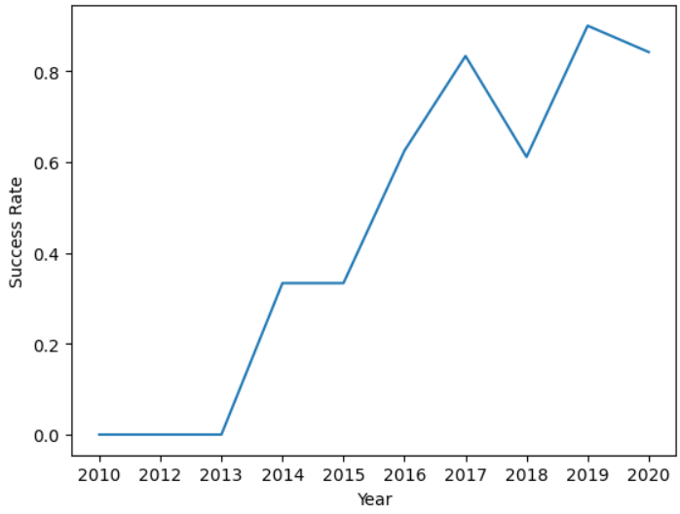
Launch Success Yearly Trend
As time went on, particularly after 2013, the launchings experienced a positive trend in success rate.
Prior to 2013, no launching was successful – This could be due to newer technology developed after.
Even though the success rate trend was advancing in a positive linear fashion, it hit a drastic decline in 2017.

Slide 23
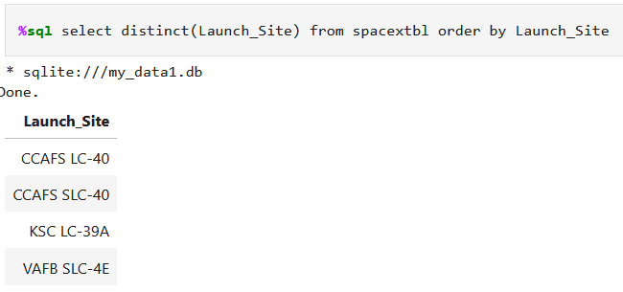
All Launch Site Names
To find the unique names of the Launch_Sites, the function/variable “distinct” was called to the used with the “Launch_Site” column; it brings up all unique names from chosen column.

Slide 24
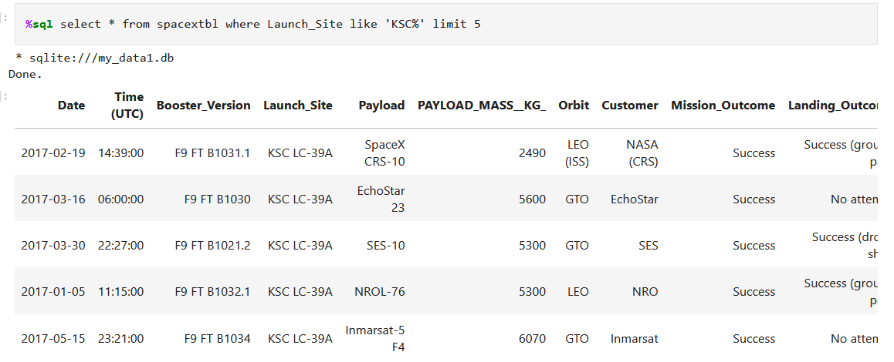
Launch Site Names Begin with 'KSC'
To find the records with a specific wording, the chosen column has to be called first.
It is then possible to add a filter to include the letter ‘KSC’.
Lasty, specifying the limit of rows by using the variable ‘LIMIT’.

Slide 25
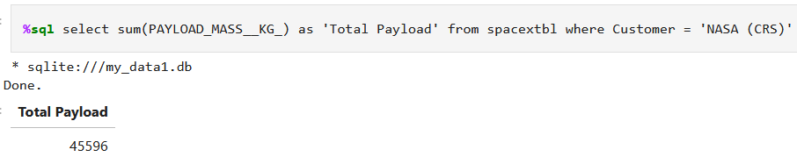
Total Payload Mass
Like the previous query, the chosen column must be filtered first.
After the column is called, mathematic operations can be performed. For this example, the function “sum” was used.

Slide 26
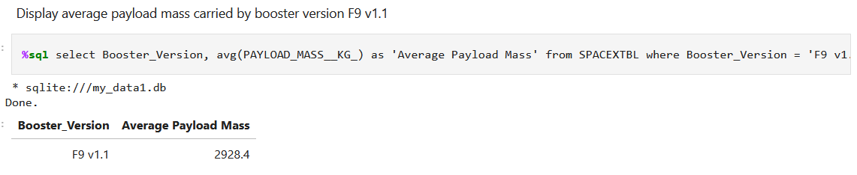
Average Payload Mass by F9 v1.1
After selecting the column chosen for this example, proceed to filter the column to only keep the records needed.
Lastly, perform mathematical operations on the remaining values.

Slide 27
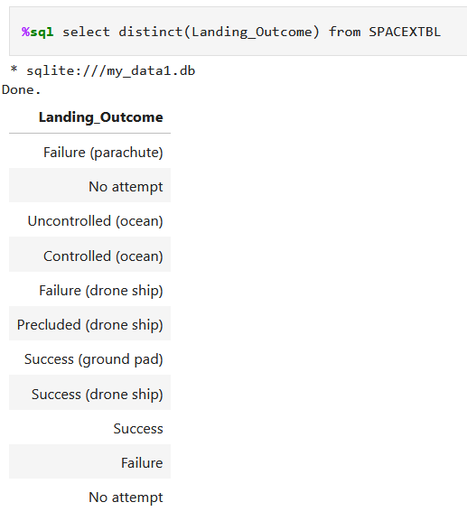
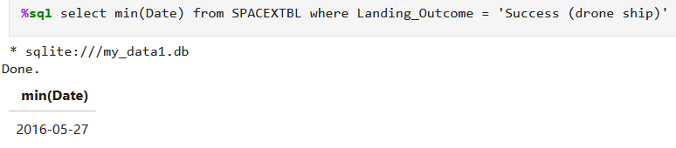
First Successful Ground Landing Date
First, it is good practice to have an idea of what is considered a successful launch and a failed one. By bringing up the distinct labels of success vs failure, we may now proceed to filter out the column where only the “successes” are noted.
The function MIN is called to bring up the earliest date with a successful launching.

Slide 28
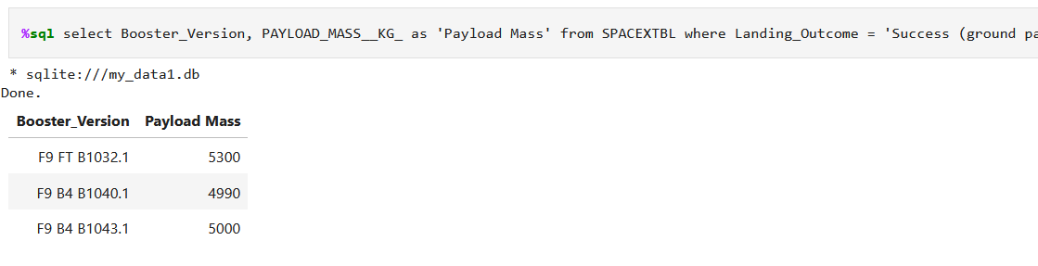
Successful Drone Ship Landing with Payload between 4000 and 6000
This problem was solved by filtering the weight from the Payload Mass column where the Landing_Outcome was a success.

Slide 29
Total Number of Successful and Failure Mission Outcomes
The COUNT keyword was used to find the total number of mission outcomes, to subsequently group them by keywords: Failure and the varying meanings of “success”

Slide 30
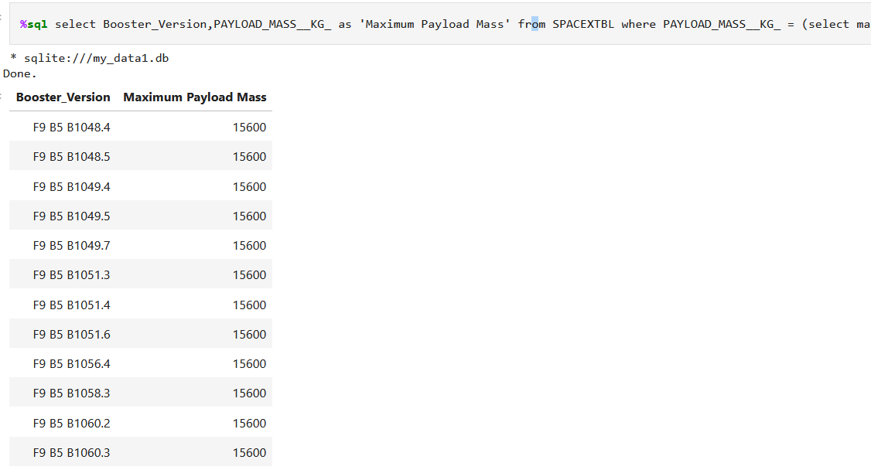
Boosters Carried Maximum Payload
This type of SQL query involves sub querying and setting the result as a variable.
First, the goal is to find the maximum payload of the vehicle from the table.
Set this equation/function as a result to the filter applied using the column PAYLOAD_MASS_KG

Slide 31
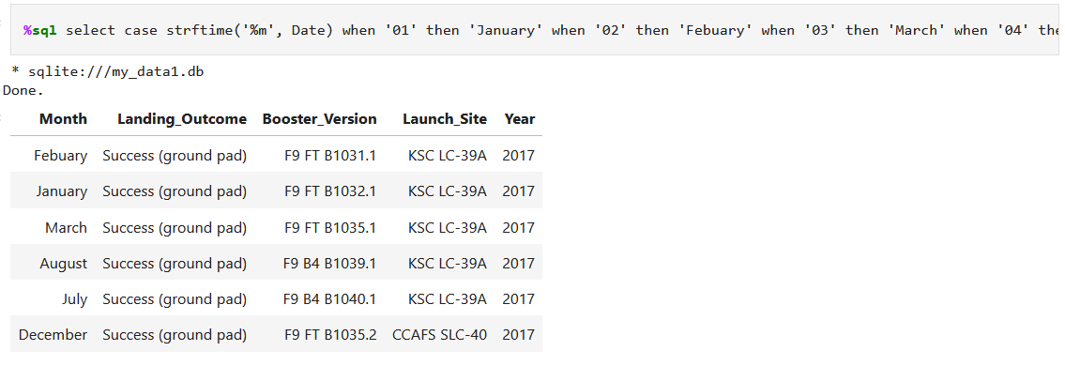
2015 Launch Records
For this query statement, the date was dissected into months and years. Each month was assigned to the name of the month, 1 being January, and so forth, by using the function CASE. Once the renaming of the months was completed, the data was filtered to only display the data from 2017.

Slide 32
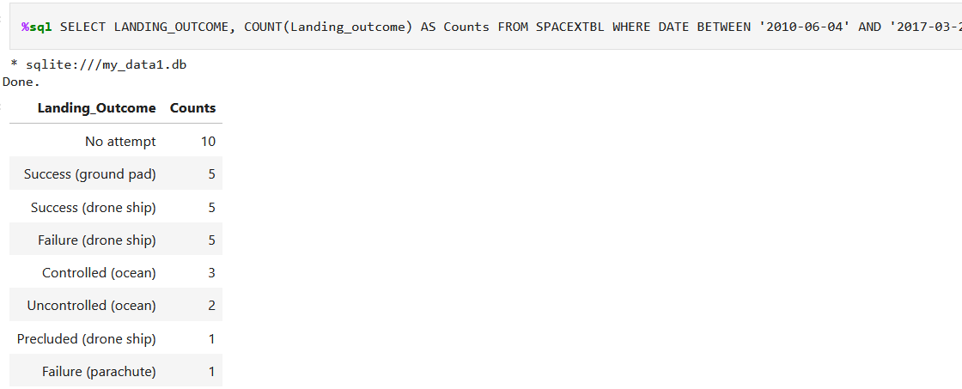
Rank Landing Outcomes Between 2010-06-04 and 2017-03-20
Lastly, the date was filtered to fit the dates above, then an additional column (displaying the number of launchings per outcome) was created and stored as “Counts”. From those steps the new data set was grouped by the Landing Outcome ordered by outcome and then sorted by descending order (DESC).

Slide 33

Section 3

Slide 34
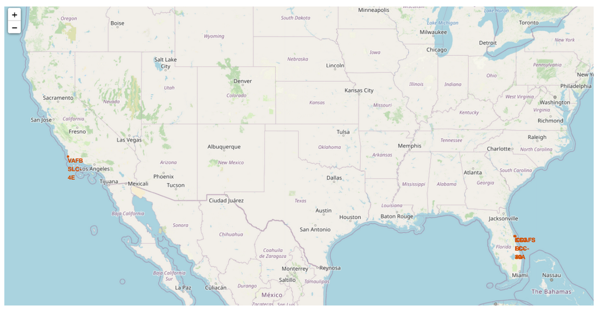
Loading the map
All launching sites observed on the map (as well from the data), are either located on the East coast or West coast.

Slide 35
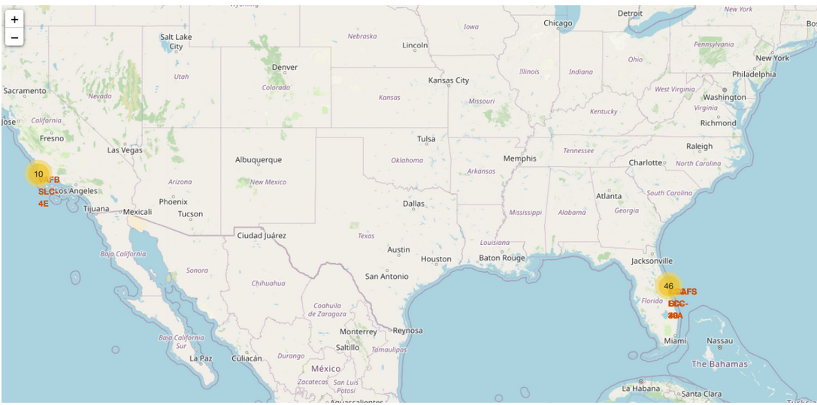
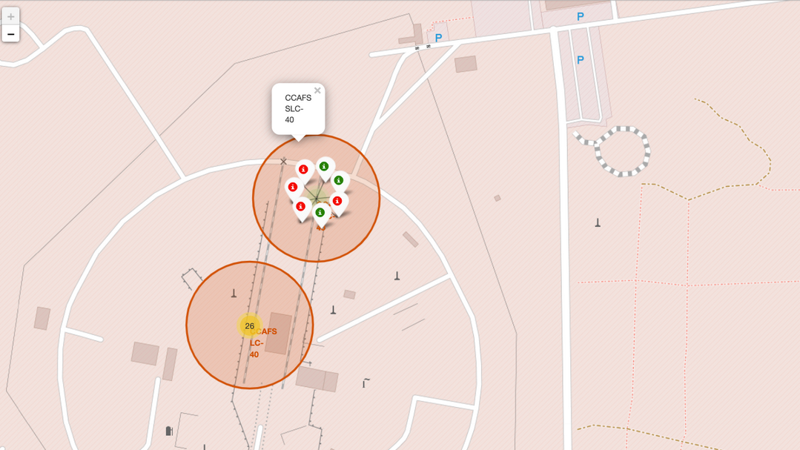
Using Folium and Markers
At this point, all launchings were grouped into clusters. Each clustered contained the launching sites color labeled, with red being failures and green being success.

Slide 36
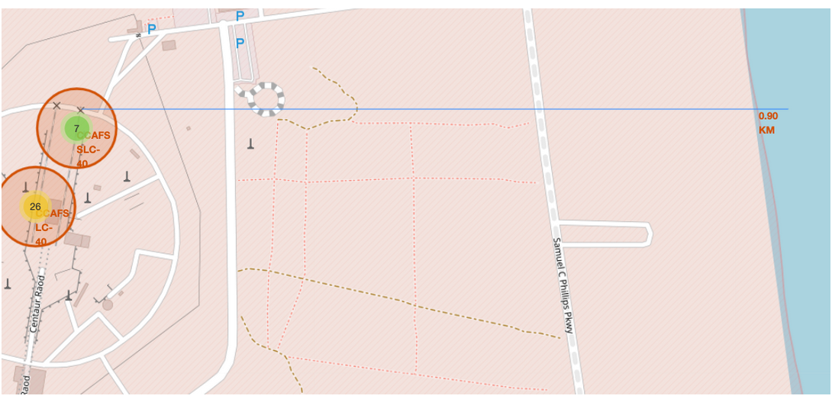
Distance from Launch Site to Mouse Position
Here we were able to find the distance between any point from the mouse position to any chosen Launching Site. In this example, CCAFS SLC site was used to find the distance to the coastline.
Lastly, these are some interesting findings:
Are launch sites in close proximity to railways?
Are launch sites in close proximity to highways?
Are launch sites in close proximity to coastline?
Do launch sites keep certain distance away from cities?
Most Launch sites are away from railways, close enough to highways (materials transportation and other logistics), and in close proximity to the coastlines. Launch sites, however, are kept at a reasonable distance away from cities in case scenarios where a spacecraft's launch doesn't go as planned and disintegrates in the air, the debris and other remains will land over the Atlantic and not overpopulated areas.

Slide 37

Section 5

Slide 38
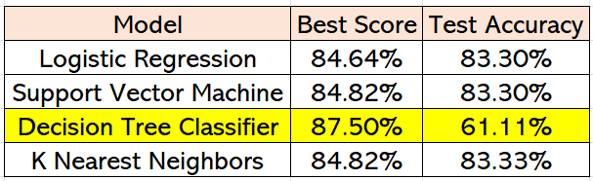
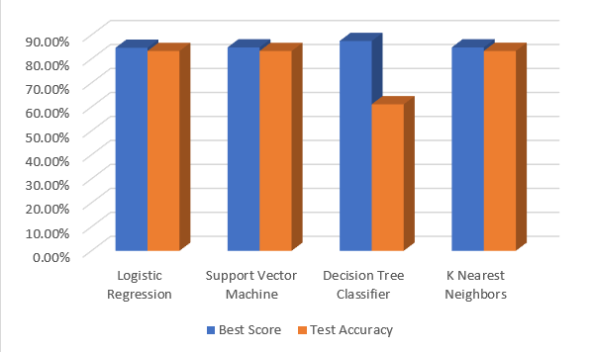
Classification Accuracy
After testing all 4 models, it was determined that the Decision Tree Classifier Model was a better fit for the data. The Decision Tree model had the highest Best Score among all models tested.

Slide 39
Conclusions
Based on the evaluation of the trends presented in the scatterplots, it can confidently be assumed that as the frequency of flights increase, the success rate of the launch increases as well.
Some of the near 100% success rate taking place at certain orbits are due to the small sample sizes of the launches. Perhaps with more attempts/data points, a more accurate prediction can be made on those orbits.
The classification model that performed the best, using the “best score” was the Decision Tree Model.

Slide 40


